Slide 1

Human Crowd Detection – Computer Vison
Group – 4
Sudhan Manovah
Abeesh Krishnapillai
Vani Balla
Altamash Arif
Harpreet Kaur

Slide 2
INTRODUCTION
This project is about developing a computer vision application that can count the number of people in a recorded video stream.
The application reads frames from the video, processes them using the YOLOv3 model, and then displays the count of people detected in real-time.
The application can handle multiple people in the frame, even if they are partially occluded or overlapping.
The YOLOv3 model used in this project is based on a convolutional neural network architecture that can detect objects at different scales and aspect ratios.
The model is trained using a technique called transfer learning, where a pre-trained model on a large dataset is fine-tuned on a smaller dataset of images containing people.

Slide 3
YOLOv3
YOLOv3 (You Only Look Once version 3) is a state-of-the-art object detection algorithm developed by Joseph Redmon, Ali Farhadi, and the team at the University of Washington. It is a deep learning-based algorithm that can detect and classify objects in real-time from images and videos.
The YOLOv3 algorithm uses a single convolutional neural network (CNN) that takes an entire image as input and outputs a set of bounding boxes, class probabilities, and confidence scores for each detected object in the image. The algorithm uses a feature pyramid network to detect objects at different scales and incorporates residual connections to improve the accuracy of the predictions.
The original implementation of YOLOv3 was written in C and CUDA, and it used the Darknet framework for training and inference. The Darknet framework provided a highly optimized implementation of the YOLOv3 algorithm, which allowed for real-time object detection on low-power devices, such as embedded systems and mobile devices.
While YOLOv3 was originally implemented using the Darknet framework, it is now possible to implement YOLOv3 using other deep learning frameworks, such as TensorFlow and PyTorch.

Slide 4
Why YOLOv3
YOLOv3 vs Faster RCNN vs SSD
Want the best accuracy? Faster RCNN - requires faster GPU
Want the fastest speed? YOLOv3 – Best fit for a moderate computation configuration
Want a trade-off between the two? SSD – requires faster GPU
YOLO v3: Better, not Faster, Stronger
Compared to yoloV2, the speed has been traded off for boosts in accuracy in YOLO v3. While the earlier variant ran on 45 FPS on a Titan X, the current version clocks about 30 FPS. This has to do with the increase in complexity of underlying architecture called Darknet.
In our implementation, 106 layer fully convolutional layers has been used for replicating YOLO v3 architecture. In YOLO v2, there was only 53 layers, but stacked extra 53 layers is the reason behind the slowness of YOLO v3 compared to YOLO v2.
The most salient feature of v3 is that it makes detections at three different scales, 320x320 or 416x416 or 608x608.

Slide 5
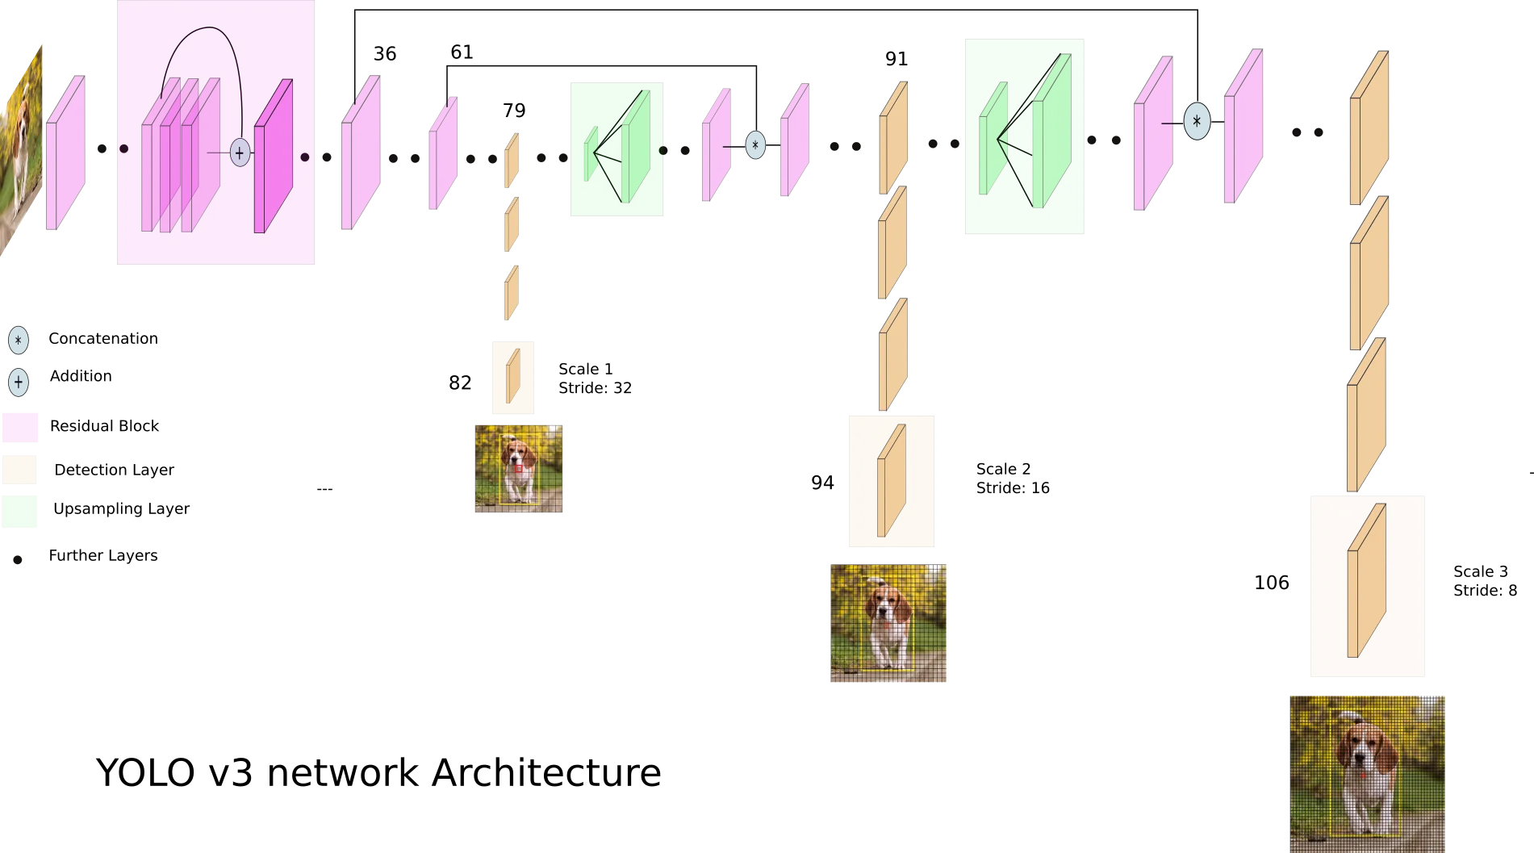

Slide 6
Darknet model
A Darknet model typically consists of several components, including:
Convolutional Layers: These layers are the backbone of the model and are responsible for learning and extracting features from the input image. In a Darknet model, the convolutional layers are typically organized into blocks, such as the Darknet-53 block used in YOLOv3.
Detection Layers: These layers are responsible for detecting objects in the input image and producing bounding box predictions and class probabilities for each object. In Darknet models, the detection layers typically include a set of convolutional layers followed by a set of fully connected layers.
Non-Maximum Suppression (NMS) Layer: This layer is responsible for removing duplicate detections and producing the final set of object detections for the input image. In Darknet models, the NMS layer is typically used in conjunction with the detection layers to filter out overlapping bounding boxes.

Slide 7
Anchor Boxes: These are pre-defined bounding boxes that are used to anchor the detection of objects in the input image. In Darknet models, anchor boxes are typically used in conjunction with the detection layers to predict the location and size of objects in the input image.
Upsampling Layers: These layers are used to increase the spatial resolution of the feature maps produced by the convolutional layers. In Darknet models, upsampling layers are typically used to combine the features from lower resolution feature maps with higher resolution feature maps to produce more accurate object detections.
Shortcut Connections: These are connections between the input and output of different layers in the model. In Darknet models, shortcut connections are typically used to allow the model to learn features at multiple scales and improve the accuracy of object detection.
Overall, these components work together to create a powerful object detection model that can accurately detect and classify objects in an input image.

Slide 8
Detection layer in CNN
The convolutional layers apply a set of filters to the image and produce a set of feature maps, where each map represents a specific feature such as edges or corners.
The pooling layers reduce the size of the feature maps and downsample the spatial resolution, which can help to reduce the computational complexity of the model and improve its generalization performance.
In YoloV3, the initial stride is set to 32, which means that the input image is downsampled by a factor of 32 in the first convolutional layer.
This downsampling is then repeated several times in the network, with each subsequent layer applying filters with a stride further reduce the spatial resolution.

Slide 9
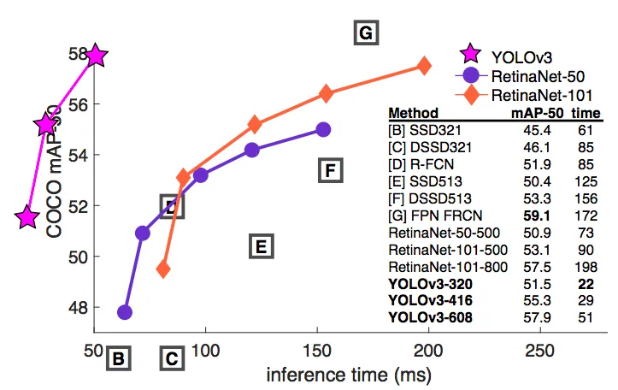
Benchmarking
YOLO v3 performs at par with other state of art detectors like RetinaNet, while being considerably faster, at COCO mAP 50 benchmark.
The Microsoft Common Objects in Context (COCO) dataset is the gold standard benchmark for evaluating the performance of state-of-the-art computer vison models.
COCO contains over 330,000 images, of which more than 200,000 are labelled, across dozens of categories of objects.
COCO is a collaborative project maintained by computer vision professionals from numerous prestigious institutions, including Google, Caltech, and Georgia Tech.

Slide 10
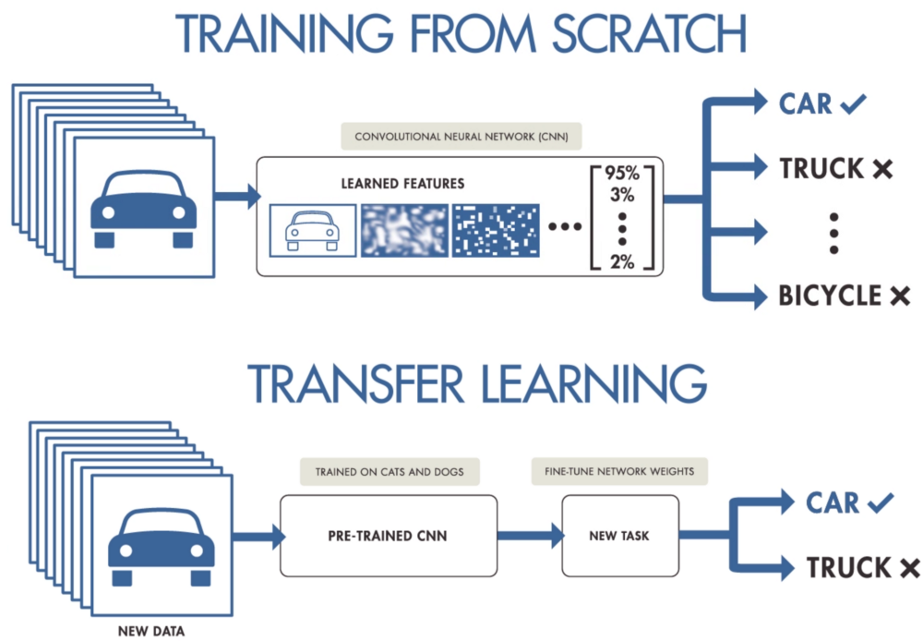
Transfer Learning
The COCO dataset also provides a base dataset to train computer vision models in a supervised training method. Once the model is trained on the COCO dataset, it can be fine-tuned to learn other tasks, with a custom dataset.
Transfer learning is the reuse of a pre-trained model on a new problem. It’s currently very popular in deep learning because it can train deep neural networks with comparatively little data.
Usually, a lot of data is needed to train a neural network from scratch but access to that data isn't always available — this is where transfer learning comes in handy.
With transfer learning a solid machine learning model can be built with comparatively little training data because the model is already pre-trained.

Slide 11
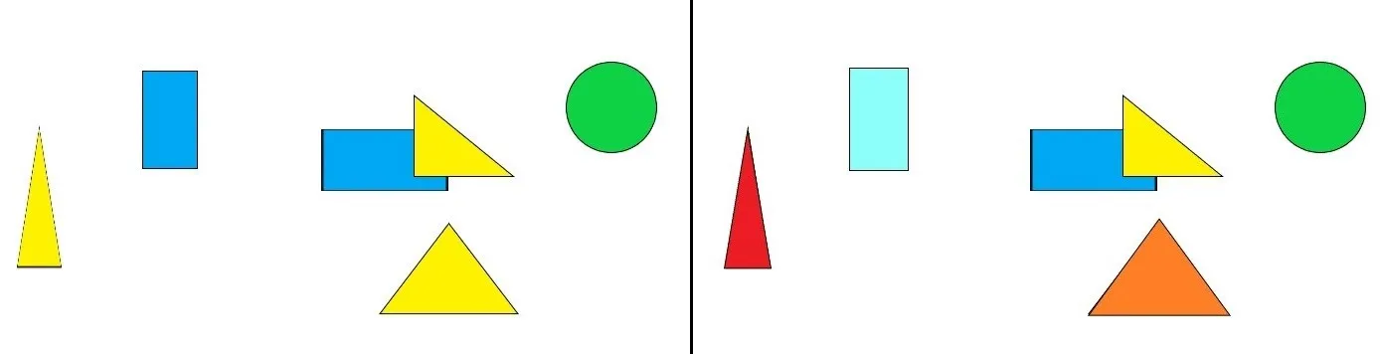
Instance Segmentation VS Semantic Segmentation
In semantic segmentation, the images are segmented based on various labels like a person, dog, cat, etc but there is no way to distinguish between two person objects. This drawback is solved in instance segmentation where along with distinguishing between different labels we are also able to distinguish between multiple objects of that label.

Slide 12
Darknet YOLO implementation in TensorFlow 2
Create a Darknet model using TensorFlow's Convolutional Neural Network (CNN) layers.
One way to create a Darknet model using TensorFlow is to use TensorFlow's implementation of the YOLOv3 object detection model
TensorFlow's implementation of YOLOv3 includes many of the specialized layers that are typically used in Darknet models, such as detection and non-maximum suppression layers.
With this approach, you can design a model that includes Darknet-specific layers and optimizations, such as the Darknet-53 backbone architecture used in YOLOv3.
Overall, while Darknet is a specialized framework optimized for object detection, it is still possible to create a Darknet model using TensorFlow's CNN layers and APIs.

Slide 13
Project Implementation
Step-by-step walkthrough for implementing a YOLOv3 object detection algorithm in TensorFlow to count the number of people in a recorded video stream. Here are the key points from each step:
Set up the environment: Install the required packages, download the pre-trained weights for YOLOv3, and set up the video stream.(used pre recorded videos due to constraints in using live feed)
Load the model: Load the YOLOv3 model architecture and weights into TensorFlow using the "yolov3.weights" file.
Preprocess the input image: Preprocess the input image by resizing it to match the input size of the YOLOv3 model and normalizing the pixel values.
Make predictions: Pass the preprocessed image through the YOLOv3 model to generate predictions for the objects in the image.
Postprocess the predictions: Filter the predictions based on the class probability and confidence score thresholds, and perform non-maximum suppression to remove duplicate bounding boxes.
Visualize the results: Draw the bounding boxes and class labels for the detected objects on each input image, and display the output video int the output cell.
Number of people found is engraved into each frame during processing and optional email alert configuration is also available

Slide 14
Skipped additional training on Pretrained yolov3
Pretrained weights are a set of parameters that have been learned by a deep neural network during the training process on a large dataset. In the case of YOLOv3, the pretrained weights were trained on the COCO (Common Objects in Context) dataset, which contains over 80 object categories.
The pretrained weights for YOLOv3 are very effective at detecting objects in a wide range of scenarios, including people, vehicles, animals, and other objects. Therefore, in many cases, it is not necessary to train the YOLOv3 model from scratch. Instead, you can simply use the pretrained weights to detect objects in your own images or video streams.
In our project , we did not consider any specific venue or specific crowd , so we did not use any other dataset to retrain models to specific labels and started using the same weights.

Slide 15
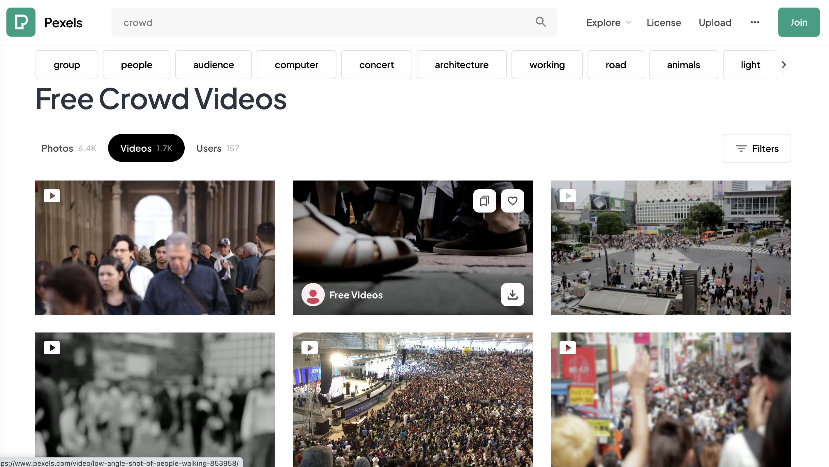
Testing - Free Crowd Videos
Used this website for collecting videos to test our specific use case –
Ref : https://www.pexels.com/search/videos/crowd/

Slide 16
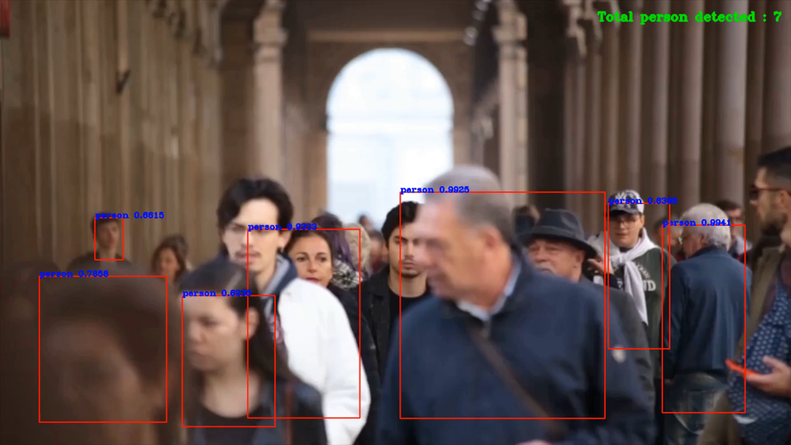
Sample Output video

Slide 17
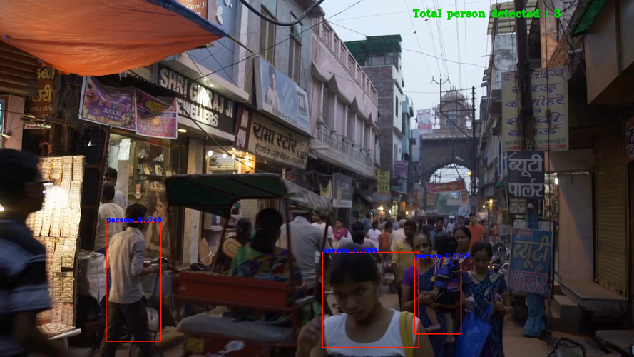

Slide 18
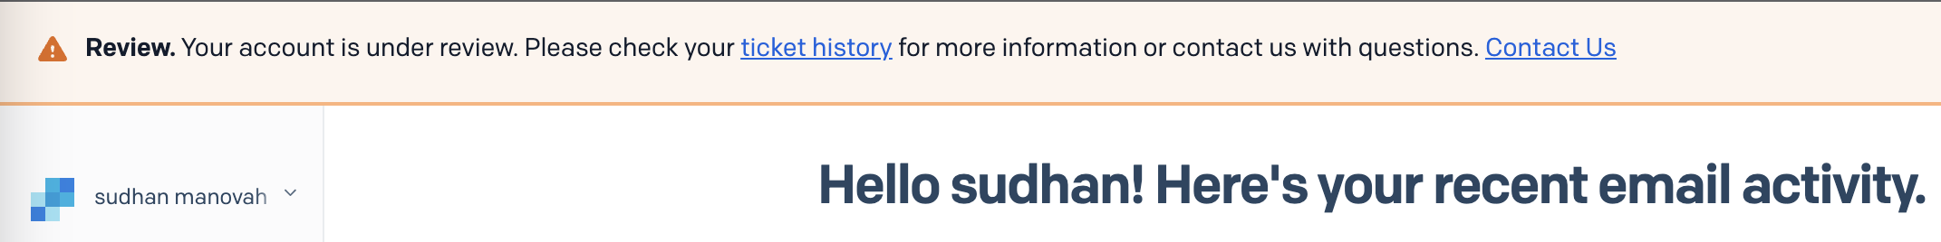
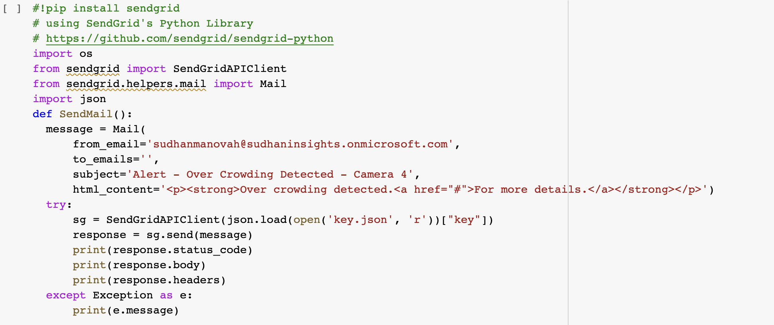
Implementation to Configure Crowd volume and send email alerts using SendGrid
Currently not tested , as SendGrid account has not activated fully

Slide 19
Possible use cases
Crowd management: The ability to count the number of people in a given area can be useful for managing crowds in public spaces such as parks, stadiums, and train stations. By knowing how many people are present in a particular area, authorities can take appropriate measures to ensure safety and avoid overcrowding.
Retail analytics: In retail settings, counting the number of people can provide valuable insights into customer traffic patterns and behavior. For example, retailers can use this information to optimize store layouts and staffing levels, and to identify peak traffic periods.
Security and surveillance: Video surveillance systems can benefit from accurate and efficient object detection algorithms, such as YOLOv3, to identify potential threats and detect suspicious behavior.
Social distancing compliance: During the COVID-19 pandemic, monitoring the number of people in a given area can be useful for enforcing social distancing guidelines and preventing the spread of the virus.
Event management: Counting the number of people attending a concert, festival, or sporting event can be useful for event organizers to manage crowds and ensure safety.
In summary, the ability to count the number of people in a video stream can have a wide range of practical applications, from crowd management to retail analytics to security and surveillance. The YOLOv3 object detection algorithm, implemented in TensorFlow, provides an efficient and accurate way to perform this task in real-time.

Slide 20
Future Improvisions
Use of yolov5, YOLOv5 (You Only Look Once version 5) is the latest version of the YOLO object detection algorithm, released in May 2020 by a team led by Glenn Jocher. YOLOv5 builds upon the success of the previous versions (YOLOv4 and YOLOv3) by introducing a new architecture and advanced training techniques that improve both the speed and accuracy of the algorithm.
It is also worth mentioning that there are other popular object detection algorithms such as Faster R-CNN, Mask R-CNN, and SSD (Single Shot Detector) that are also actively developed and widely used in computer vision applications.
Develop mobile application to make use of the model trained and extensively test with live feeds.

Slide 21
Participation Report
Sudhan Manovah: Conceptualization and python code development
Abeesh Krishnapillai: Exploration on darknet,yolov3 and TensorFlow to create object detection model
Altmash Arif: finding source of crowd videos and testing the model with multiple type of crowd videos
Vani Balla: Analyzed to find similar published literatures related to the concept
Harpreet Kaur: preparation of presentation and cleaning & organizing Jupiter notebook files.

Slide 22
Thank YOU!!!

